Slide 1

Manufacturing Downtime Analysis Dashboard
Developed in Microsoft Power BI
Presented by: Mohamed Rashwan

Slide 2
Project Background & Business Problem
Manufacturing line experiencing repeated downtime losses.
Lack of unified visibility across machines, operators, and shifts.
Need to analyze root causes affecting production stability and output.
Project Objectives & Scope
Measure actual production efficiency vs. targets.
Identify major downtime categories and top contributors.
Analyze batch-level variations and operator performance gaps.
Deliver actionable recommendations for improvement.

Slide 3
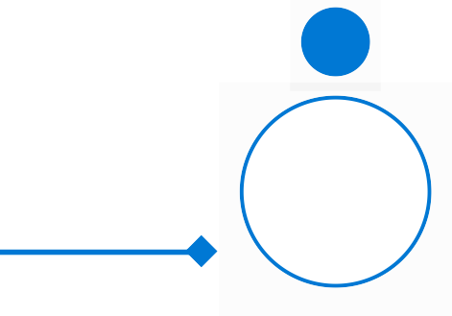

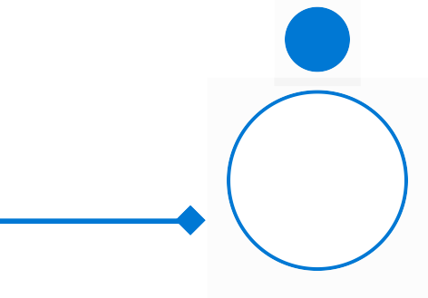







Dataset Overview
Data sourced from production logs and downtime records.
Includes two fact tables (productivity + downtime).
Five dimension tables: products, operators, downtime factors, date, time.
Covers multiple shifts, batches, and production cycles.
5
1
2
2
3
3
4
4
Data Modeling
Build relational star schema in Power BI.
DAX Development
Define KPIs for downtime, productivity, and efficiency.
Visualization
Design interactive dashboard for management review.
Data Acquisition
Consolidate production and downtime logs from Excel.
Data Transformation
Clean, standardize, and validate in Power Query.

Slide 4
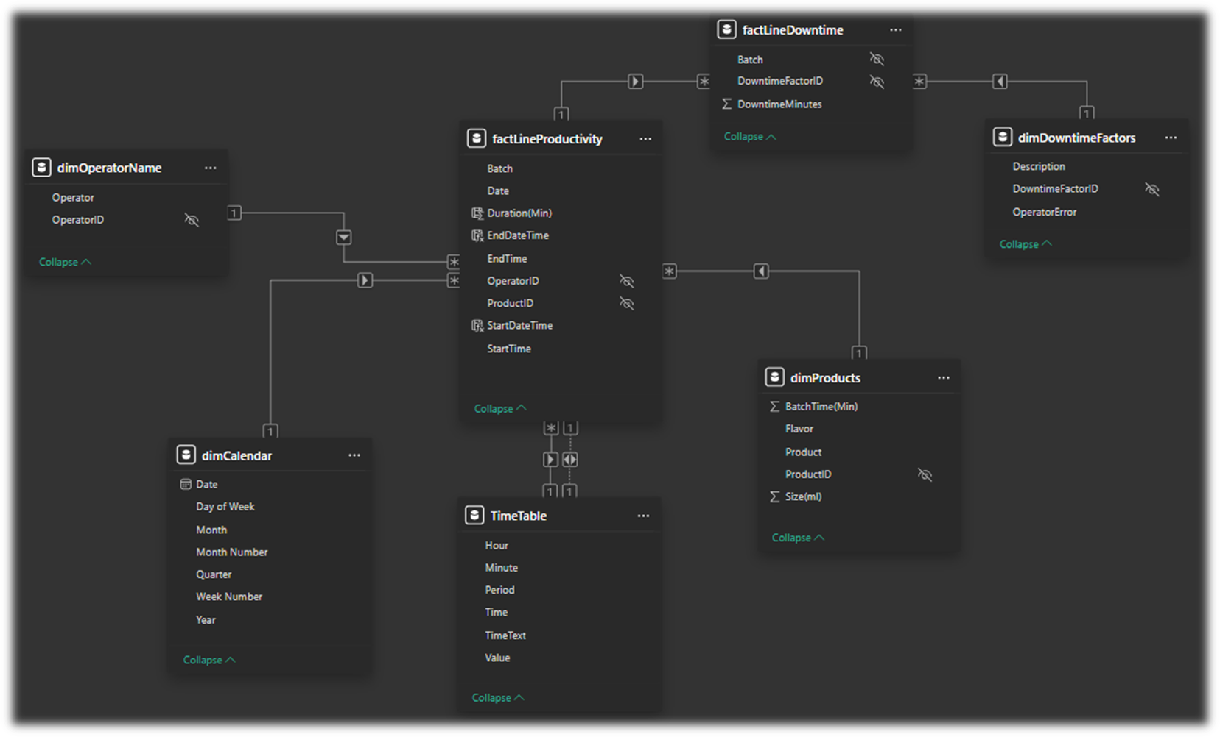
Data Model & Relationships
n tables for operators, products, time, and downtime factors. The model enables cross-sectional analysis by shift, product, and downtime category, providing flexibility for business insights.

Slide 5
Key KPIs & Metrics Defined
List of key KPIs
Overall Production Efficiency: 64.02% Indicates how effectively the production line operated compared to total available time
Total Downtime: 23h 08m Represents the total accumulated time where production was stopped due to machine, operator, or material-related issue
Batch Target Achievement: 7.89% Shows the percentage of batches completed within the planned target time — significantly below the desired benchmark
Average Downtime per Cycle: 23 minutes Measures how much time is typically lost in each production cycle due to stoppages.
Why these KPIs are important ?
These KPIs collectively enable management to monitor performance, detect inefficiencies early, measure improvement over time, and make data-driven decisions that enhance productivity, reduce waste, and increase overall manufacturing reliability.

Slide 6

Power BI Dashboard

Slide 7
Recommendations
Recommendations (0–30 Days)
Perform preventive maintenance for critical machines.
Investigate CO‑600 line downtime through root‑cause analysis.
Improve SOPs for machine adjustment.
Deliver quick training for operators on top error patterns.
Recommendations (1–12 Months)
Introduce predictive maintenance powered by downtime patterns.
Develop shift‑based KPIs for productivity alignment.
Automate inventory monitoring to reduce shortages.
Enhance batch workflow to improve target achievement >25%.

Slide 8
Conclusion
Dashboard provides actionable visibility into system inefficiencies.
Expected impact: +5–10% efficiency and 20–30% downtime reduction.
Next steps: real-time integration and quarterly dashboard reviews.
Supports smarter planning and improved operational reliability.
Enables proactive maintenance and faster issue resolution.
Enhances decision-making through consistent KPI monitoring

Slide 9
Thank you

